Slide 1
JavaScript
Ashish Bansal

Slide 2
Understanding Java Script Behaviors
Java Script Programming approach
Data Types in Java Script
Objects and Functions

Slide 3
It is an interpreted language (it executes without preliminary compilation)
Usually embedded directly into HTML pages
JavaScript gives HTML designers a programming tool
  JavaScript can be used to validate data
  JavaScript can be used to detect the visitor’s browser
JavaScript can put dynamic text into an HTML page
JavaScript can react to events
JavaScript can read and write HTML elements

Slide 4
Understanding <Script> html tags.
And Alert(“Hello World”);

Slide 5
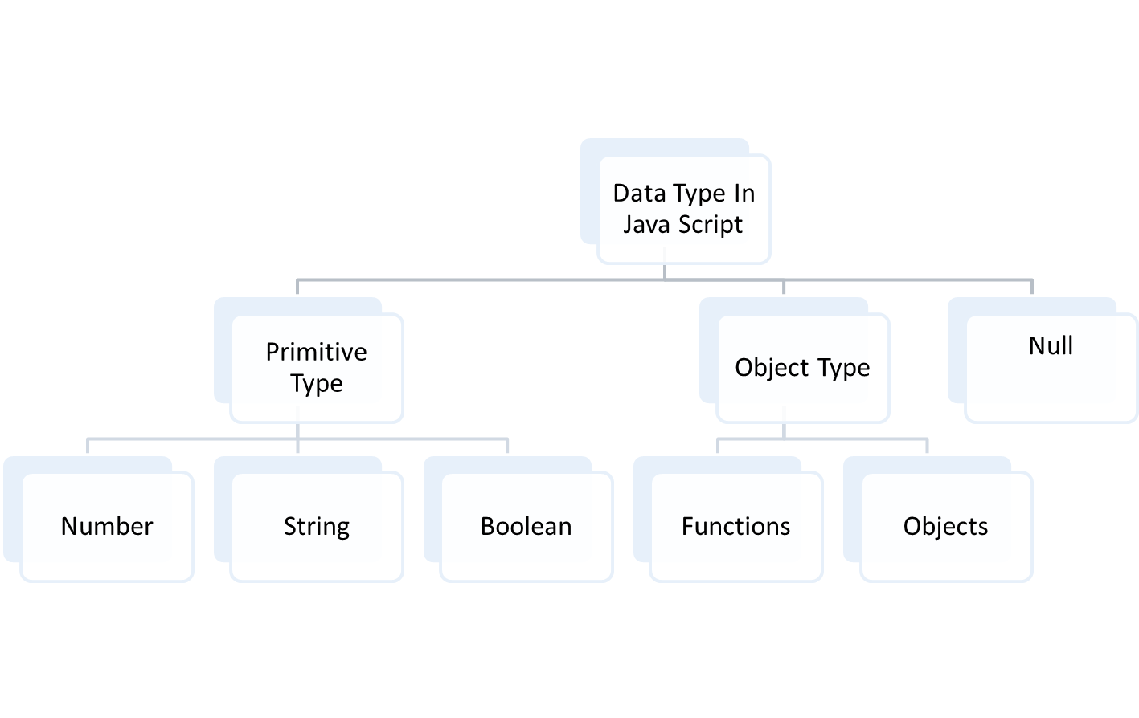

Slide 6
Java Script is the Scripting language.
Java Script is the dynamic typed language.
Java Script is the Functional Programming language.
And Java Script is the Object Oriented language

Slide 7
String
Number
Boolean
+,-,*,=,= =,/,% , > , < , >=,<= , != , = = =
Typeof, instanceof

Slide 8
If statement
Else if statement
Switch statement
Loops
  While
  for
Break and continue

Slide 9
Functions in Java Script is also consider as data and Object.
Function keyword is used to create function.
Java script functions must return some value or otherwise undefined.
In java Script variables has function scope.

Slide 10
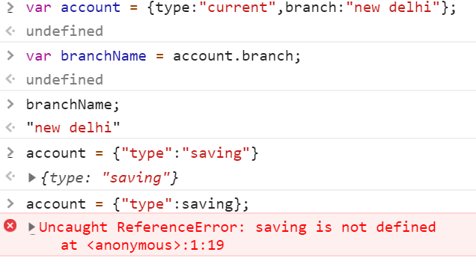
Object and its properties
JSON
Arrays
Functions
---------------------------------------------------------------------------------------------
Notes:
Java script provides unordered collection of properties
properties are String and value associated with properties can be anything.
Var Car = { “color” : “red”, model : “Honda”};
Here its not necessary to mark property within single or double quotes (java script treat it as String always)

Slide 11
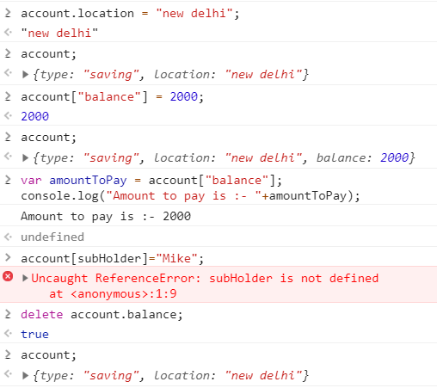
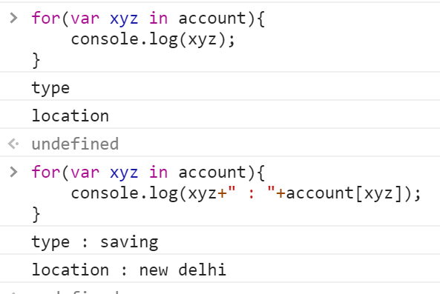
1) Creating property through .(dot) and [ ] brackets.
2) Reading properties
3) Deleting properties.
4) Iterating over properties.
----------------

Slide 12
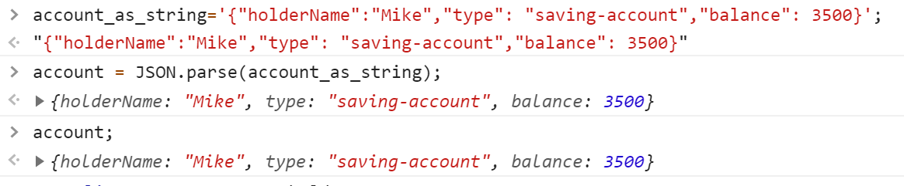
Creatation of java script object through JSON.
JSON.parse(str);

Slide 13
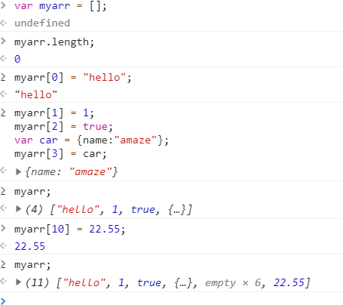
Window object is linked the things together.
Arrays
  Stores Data as Object.
  not restricted to size.
  not restricted to type.
  Length property of array
  Iteration.

Slide 14
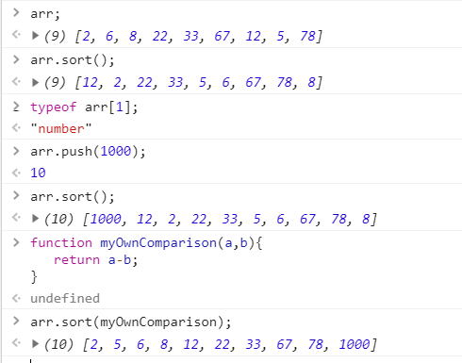
Concat
Push & pop
Join
Slice
Sort

Slide 15
Similar to most of the programming language JavaScript also provide function.
Function allows you to define a block of code, give it a name and then execute it as many times as you want.
A function definition has four parts
  The first part is the reserved word function.
  The optional second part is the function's name.
  The third part is the set of parameters of the function, wrapped in parentheses.
  The fourth part is a set of statements wrapped in curly braces. These statements are the body of the function. They are executed when the function is invoked.
function xyz(a,b){
// function body
}

Slide 16
Function Expression:
  JavaScript allows you to assign a function to a variable and then use that variable as a function
var add = function calSum(val1, val2) { return val1 + val2; };
Anonymous function
  Are function having no name.
  Must be assigned to a variable.
  Anonymous function is useful in passing callback function, creating closure.
var mymsg = function () {alert("Hello"); };
mymsg();
var mymsg1 = function (var1) {alert("Hello “+var1); };
mymsg1("Ravic")

Slide 17
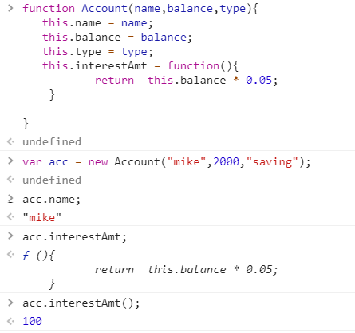
Creation of Object
This.
constructor

Slide 18
JavaScript allows you attach new properties to an object at any time .
  var Obj1 = new Employee();
  Obj1.age = 15;
  alert(Obj1.age); // 15
  var Obj2 = new Employee();
  alert(Obj2.age); // undefined
Here age property is attached to Obj1 instance. However, Obj2 instance will not have age property because it is defined only on Obj1 instance.
So what needs to do if you want to add new properties at later stage to a function which will be shared across all the instances?
  The answer is Prototype.

Slide 19
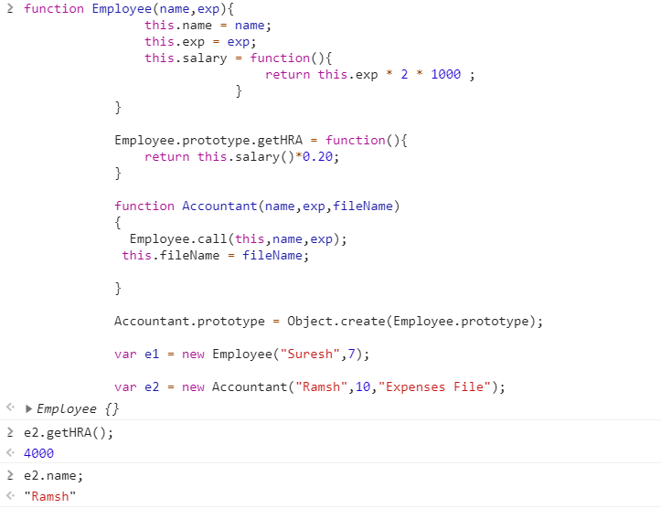
Object.create( );
Notes:
The Object.create() method creates a new object, using an existing object

Slide 20
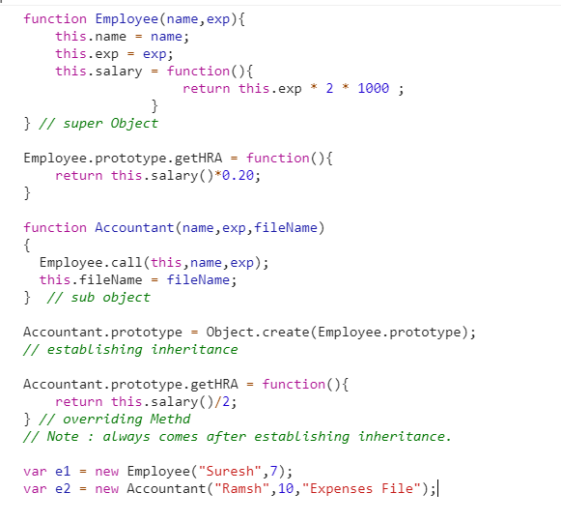

Slide 21
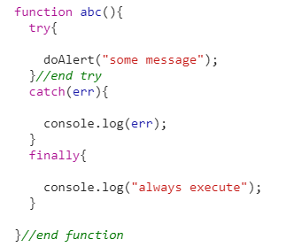

Slide 22
